Slide 1
Financing & supporting (Swiss) water entrepreneurs in frontier markets
SIIA Impact Summit Zug
18 September 2018

Slide 2
The Swiss Bluetec Bridge explained
Inventor
Question
“How can I fill the gap between big and expensive urban plants and the “no-water” situation in rural villages, where 80% of people live? And how to put in place smart technologies together and use only locally available consumables?”
Image source: https://adn-co.news/actualites/details/retour-d-evenement-peut-on-encore-innover-dans-le-paiement-en-europe

Slide 3
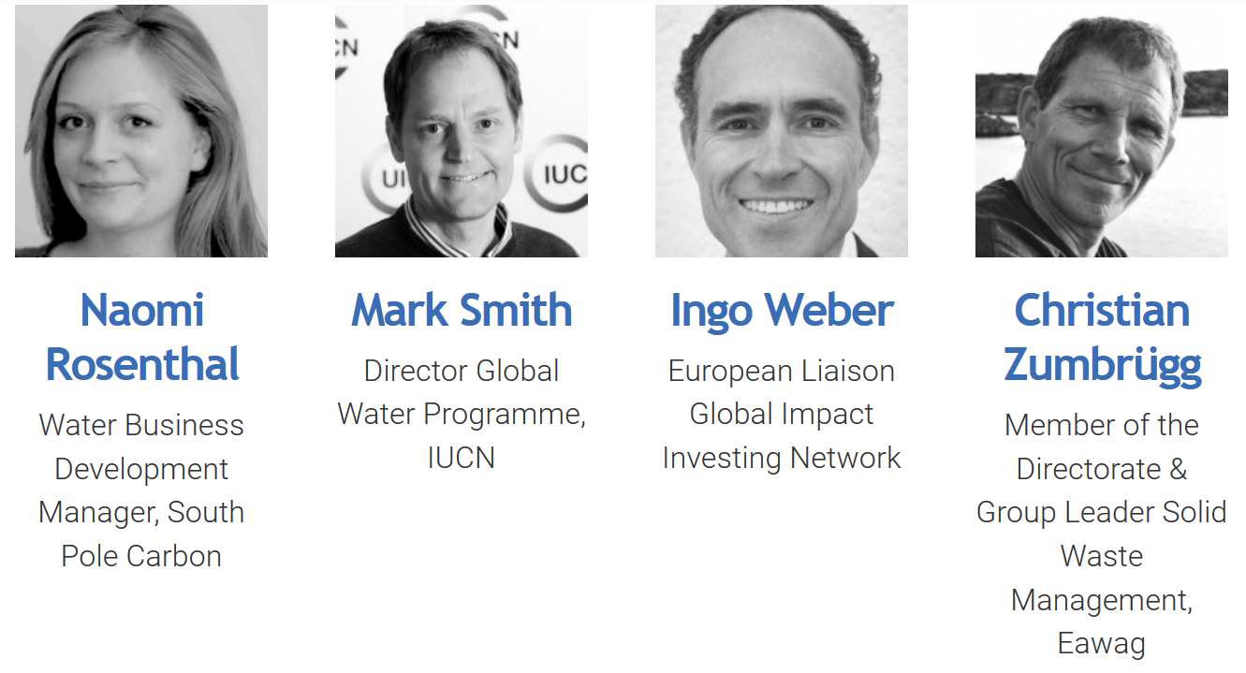
Selection Committee (as of 31.12.2017)

Slide 4
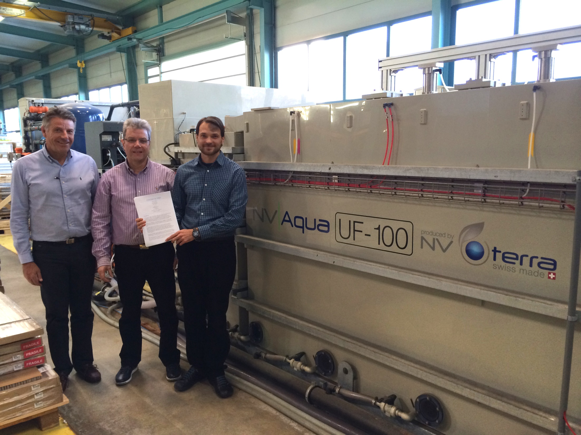

Slide 5
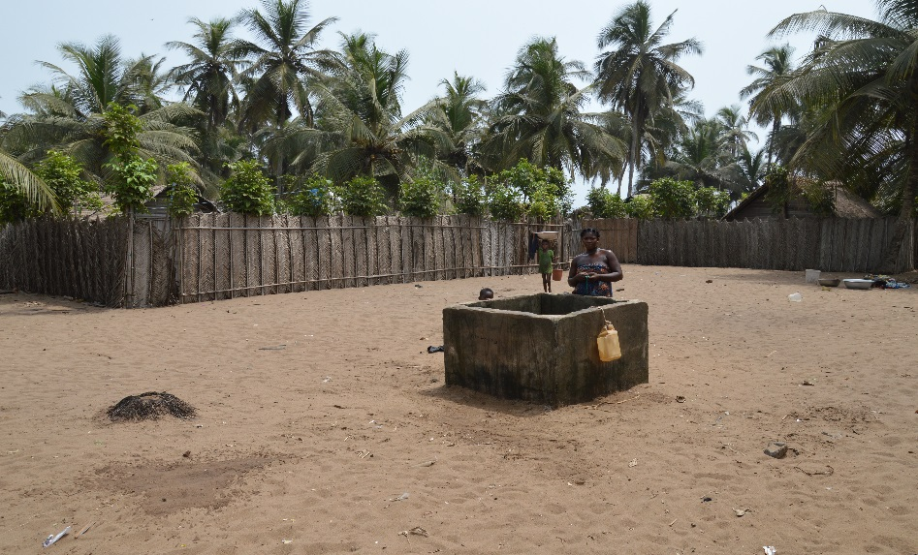
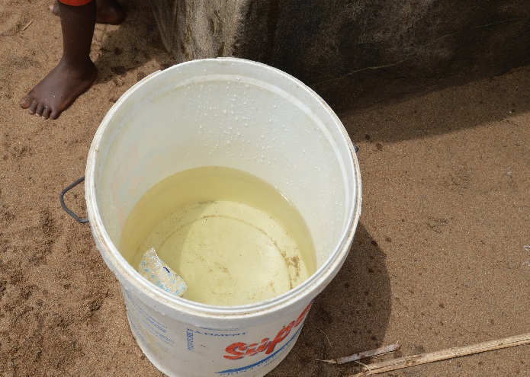
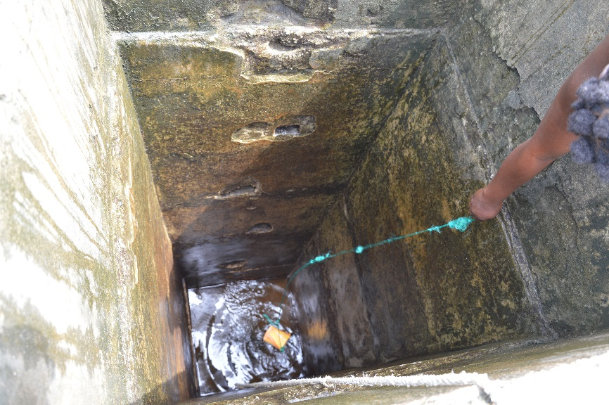
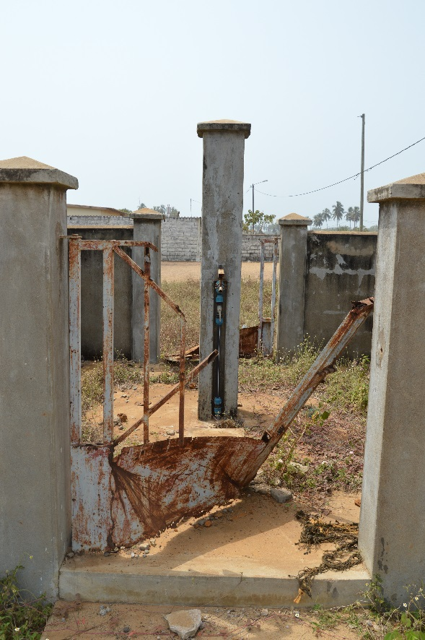
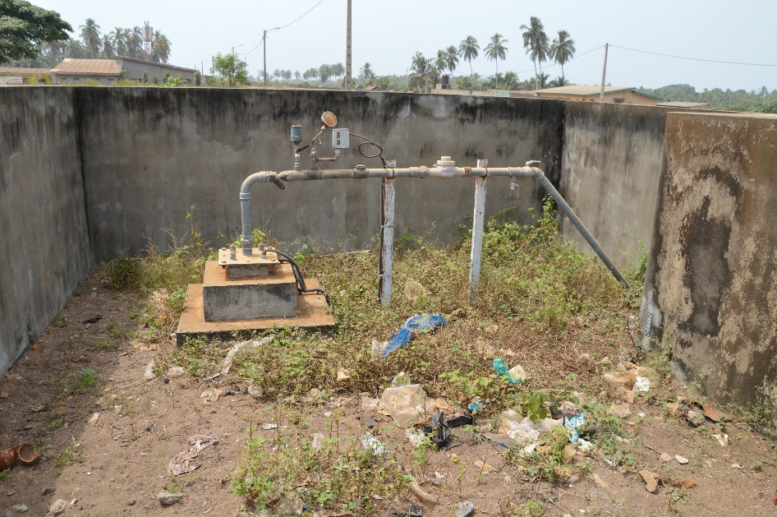
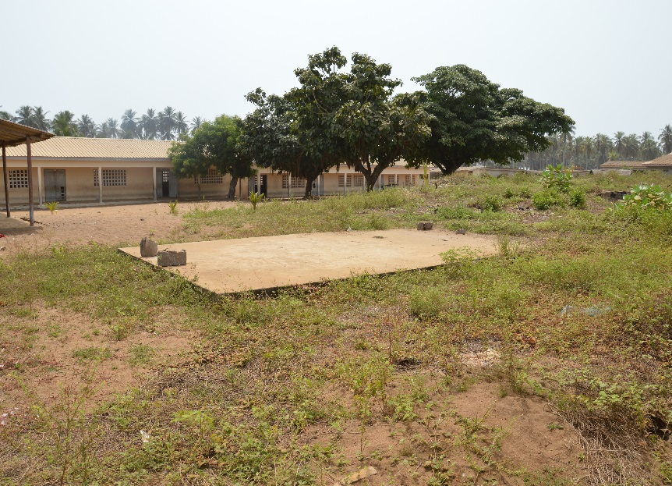
Before

Slide 6
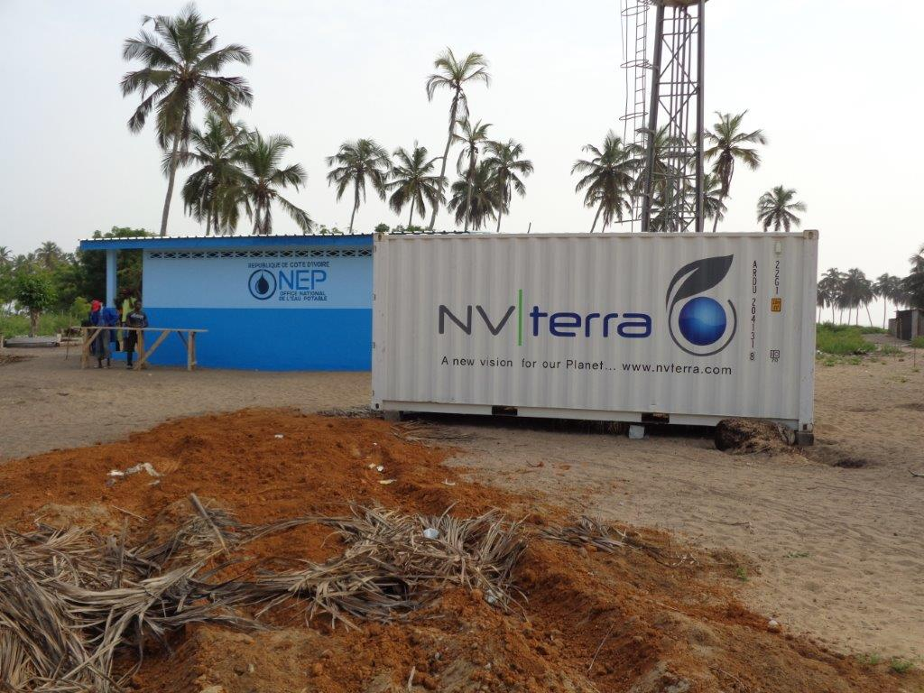
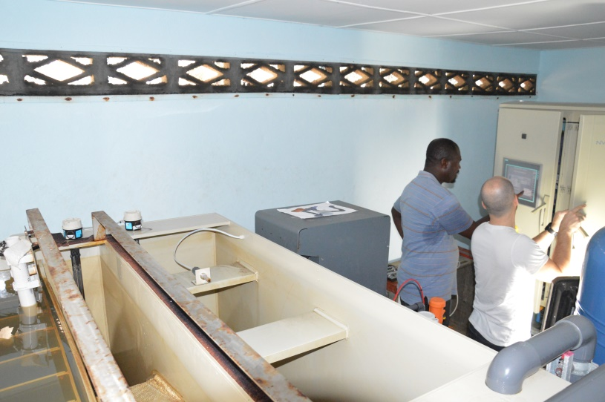
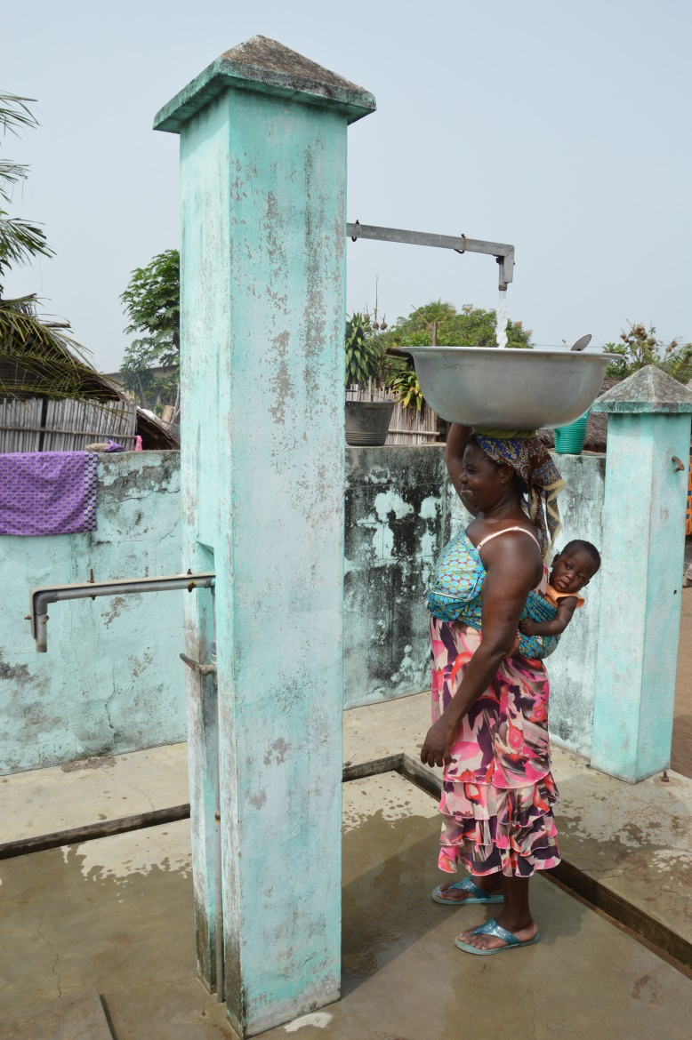
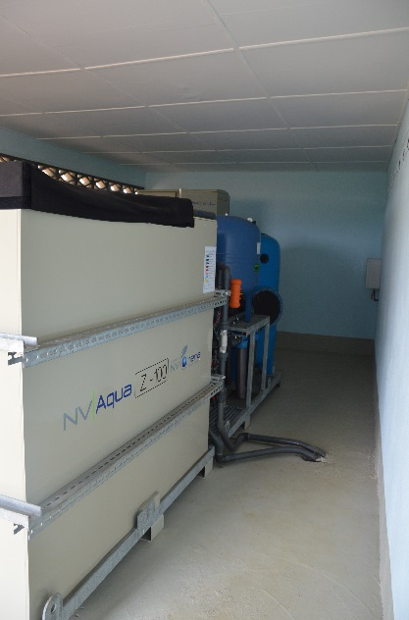
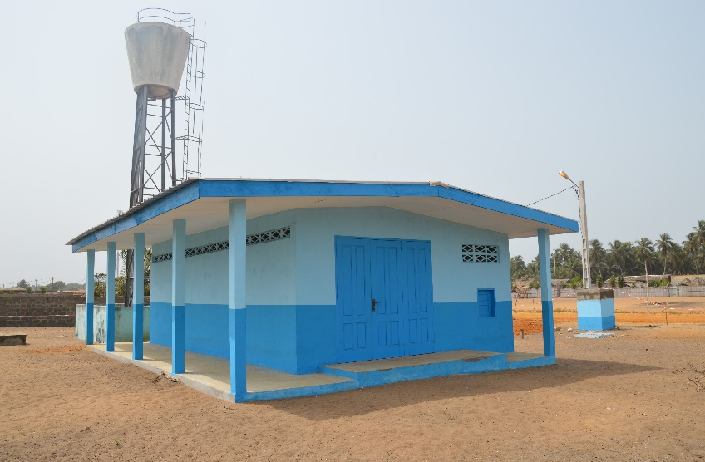
After

Slide 7
Results
Portfolio
Other partners

Slide 8
Cumulated Impact (as of 31.12.2017)
Sales of 1.9 million Swiss Francs (5 companies)
Reached over 360,000 people (7)
Created 28 FTE jobs in CH and 183 FTE jobs (FTE) in markets (9)
What else?
Improved access to safe and affordable water
Reduced water-related diseases
Saved 50,000 litres of diesel and 140 tons of CO2
Job training
Zero infections out of 8 surgeries (Sterilux)
Provided space for tenants, energy &communication services
Significant leverage for every Swiss franc spent

Slide 9
But…
Image source: https://blog.zenika.com/2018/03/07/visualiser-et-optimiser-son-time-to-market-partie-14-la-chaine-de-valeur/

Slide 10
Call for Funding
Co-fund 1-2 calls for proposals (CHF 150-300k)
Participate in Selection Committee
Contribute to shaping phase 3 (CHF 2-5m)
Become an Ambassador
Bridge
Provide growth capital (equity, mezzanine, loans)
Buy out Bridge loan
Companies

Slide 11
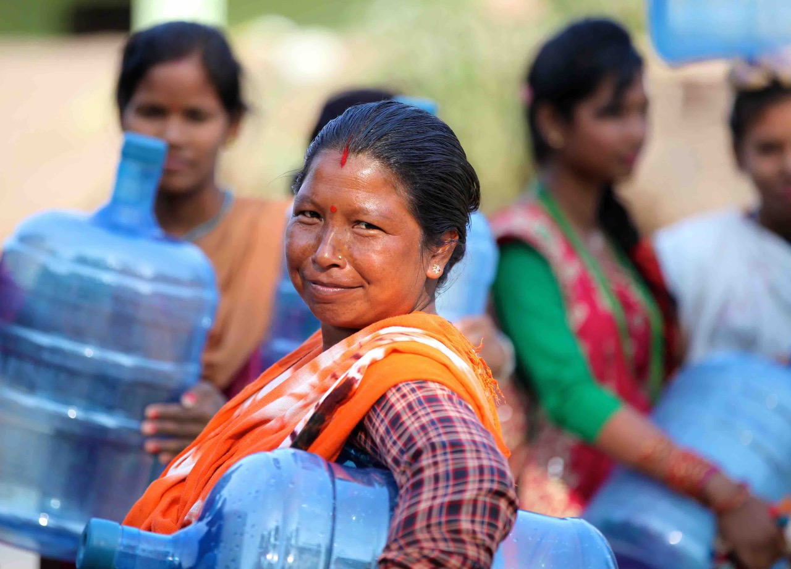
Thank you!
Violette Ruppanner, Manager, Swiss Bluetec Bridge
+41 21 623 9118, +41 78 870 7144
manager@swissbluetecbridge.ch, www.swissbluetecbridge.ch

